Slide 1
An Example of a Fundamental Issues in Social Computing Research: Hidden Commitments
Influence Across Socio-Technical Contexts and Social Technology Platforms

Slide 2
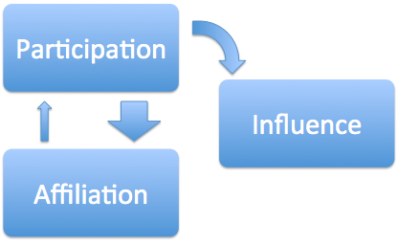
Influence (A Specific Construct)
Components of Influence
Affiliation – How big is my audience? Who listens?
Participation – What do I say; to what extent do people interact with me?
Three Examples
Facebook
Twitter
GitHub

Slide 3
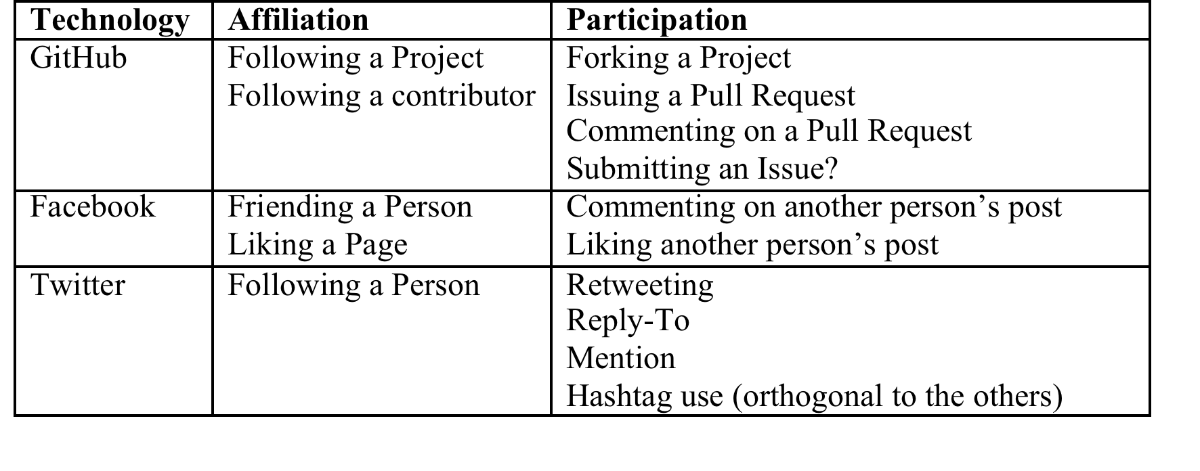
A Social Technology Influence Matrix

Slide 4
Levelism
Levels
Abstraction
Organization (ontological commitments)
Explanation (epistemological commitments)
Gradients of Abstraction
Avoid pitfalls in working with leveled data
Align organization of data with with what you are trying to explain in order to avoid hidden epistemological commitments
Align Digital and Analogue Data (Derive organization of traces from social science analysis)
Notes:
Levelism is a branch of philosophy concerned with how levels of abstraction (LoA’s) are applied in scientific inquiry. There are two main categories of abstraction, Levels of organization (LoO’s), which make ontological commitments; and levels of explanation (LoE’s), which make epistemological commitments. The construct of gradients of abstraction (GoA’s) are applied to suggest levels of greater or lesser abstraction, with all the components of the higher levels composed of the more granular, lower levels. Levelism foregrounds the connection between the data aggregated through variables (discrete or analog) in observables (data that can be captured) (Floridi, 2008) in scientific inquiry.
Our purpose in introducing the philosophical notion of levelism is to point out that wrestling with how to make social sense of discrete, electronic trace data is a category of problem long reasoned about more abstractly in the foundational scientific field of philosophy. How we make sense of behaviors and identify patterns of influence can then be grounded in established modes of reasoning about variables, observables and abstractions in science; and we can avoid well-known pitfalls in logical reasoning about leveled data.
Let us briefly unpack levelism in the context of explaining communication oriented influence in social technologies (see (Floridi, 2008) for a thorough logical explication of levelism). Influence is classified as a LoE. We use traces of interaction to explain influencing behaviors in social technology; to build models and develop theory. The trace data available from the 3 social technologies we focus on here each come to us in a concrete, fine-grained form; often with millions of rows. This data is too granular for us to derive findings from directly, so we must therefore create abstractions.
Levelism posits that if the LoO’s we define by aggregating trace data are not clearly aligned with the discrete and analogue data we collect, as well as the LoE’s we are focused on, we inevitably make hidden epistemological commitments. An example of such an epistemological commitment might be to suggest that the identification of clusters or flow abstractions derived from the traces of behavior in each of the 3 social technologies described here constitute measures of influence. To do so would be to assert that the LoA of a cluster, and the LoO of constituent subgroups of behavior correspond with influence; the ontology of “cluster” in this case makes an ontological commitment to defining the structure of abstractions, and has a powerful effect on our epistemic commitments to questions of influence. In this case we conflate abstraction and organization of data (computationally derived clusters and flows) with the construct of influence, which is what we are trying to explain.
To explain influence (our LoE) across social technologies, we suggest a corresponding need for LoO’s specific to the electronic trace data, practices and purposes for participation in each social technology. To measure and instrument influence across technologies, we will define GoA’s for each that share an LoA at some appropriate, high level. In the next sections, we address these specifics one social technology at a time, and then describe a shared abstraction afterwards Discrete data has a finite number of possible values. In the analysis of influence, trace data is discrete. Analogue data has an indeterminate number of values. In the analysis of influence, qualitative observations we make in a reflexive analysis of the data would be considered analog (Floridi, 2008; Saab & Riss, 2011).
Recall – LoO is an ontological abstraction, and LoE is an epistemological abstraction.

Slide 5
Levels of Organization in Social Technologies
Facebook
Twitter
GitHub

Slide 6
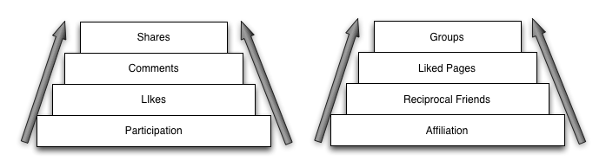
Levels of Organization on Facebook
Gradients of abstraction

Slide 7
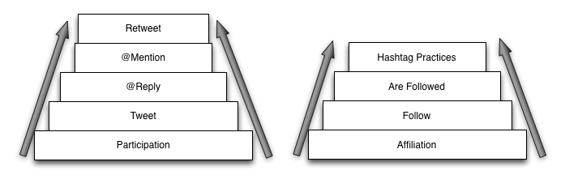
Twitter LoO
Gradients of abstraction

Slide 8
Signaling Markers in Twitter

Slide 9
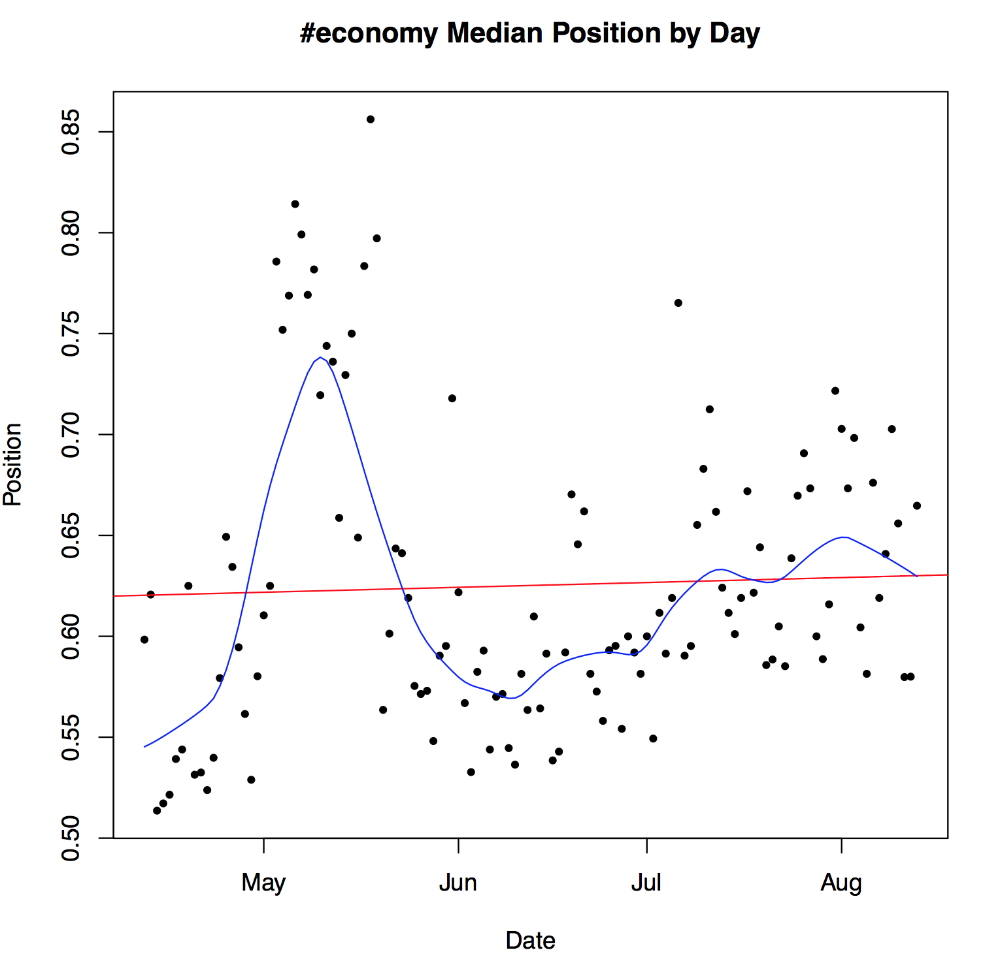
Signals in Twitter

Slide 10
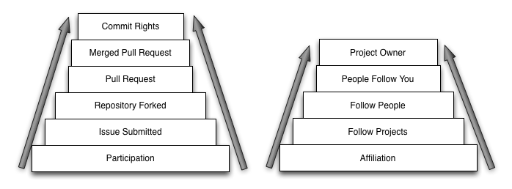
GitHub LoO
Gradients of abstraction

